Slide 1
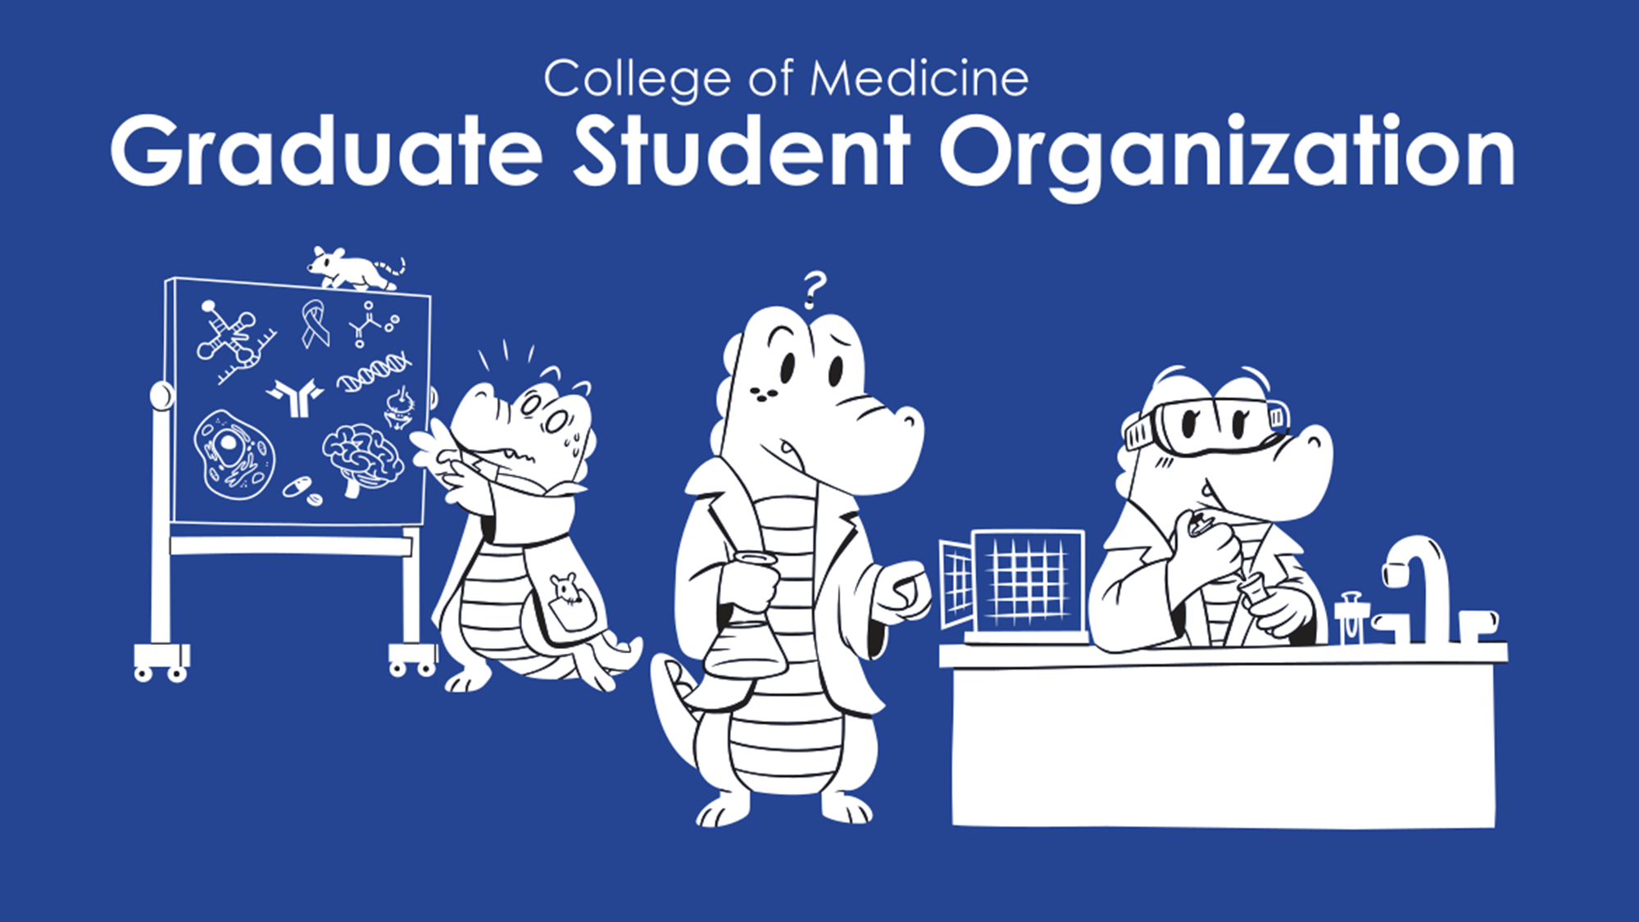

Medical Graduate Student Organization
eSteve
August 2025
General Body Meeting

Slide 2
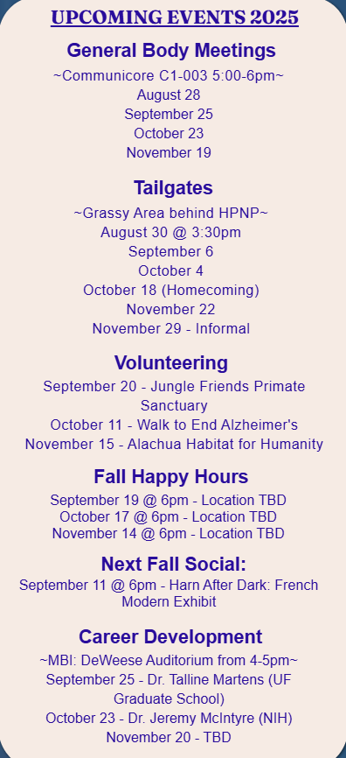
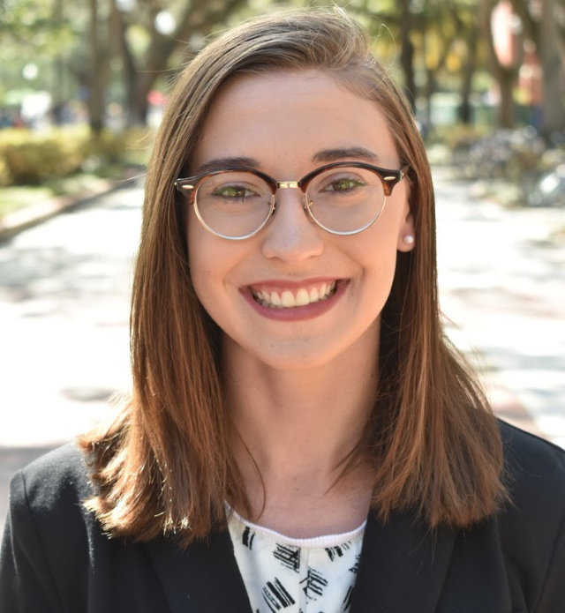
President
Tiffany Nelson (she/her)
5th Year, BMS, Immunology/Microbiology
Announcements
Welcome!!
The website has been updated: https://gsovpres.wixsite.com/gsobms
Discussion on crewneck design at the end
Please email me if you need anything! Tiffanysnelson@ufl.edu
Fall Fun Fact!
The "pumpkin spice economy" generates hundreds of millions of dollars annually, with global sales projected to reach $1.1 billion by late 2025.

Slide 3
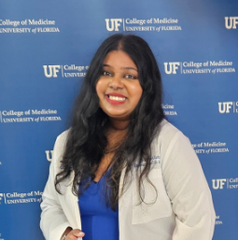

Vice President
Enter Photo Here
Ajisha Alwin (she/her)
5th Year, BMS, Immunology/Microbiology
Announcements
No announcements, welcome to the new academic year!
Please reach out if you need anything :)
Fun Fact!
In 8 BC, this month was named Augustus, in honor of the Roman emperor Augustus.
Which is now August!

Slide 4
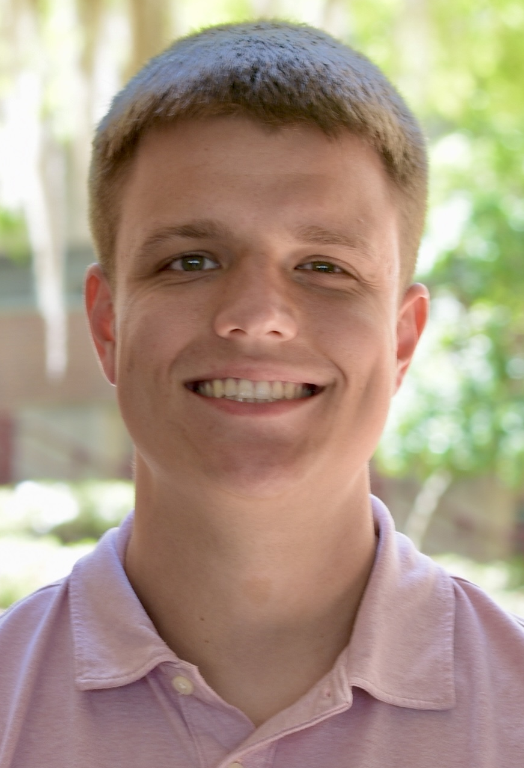
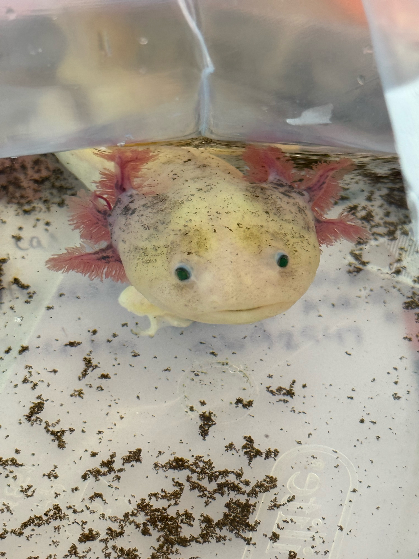
Treasurer
Enter Photo Here
Zachary Markovich (He/him)
4th year, BMS, Pharmacology
Announcements
Please let me know about any dietary restrictions or recommendations for catering for the GBMs.
Fundraiser ideas?
Axolotls come in a variety of colors including green, brown, white, copper, pink eyes, and gold (among others)

Slide 5
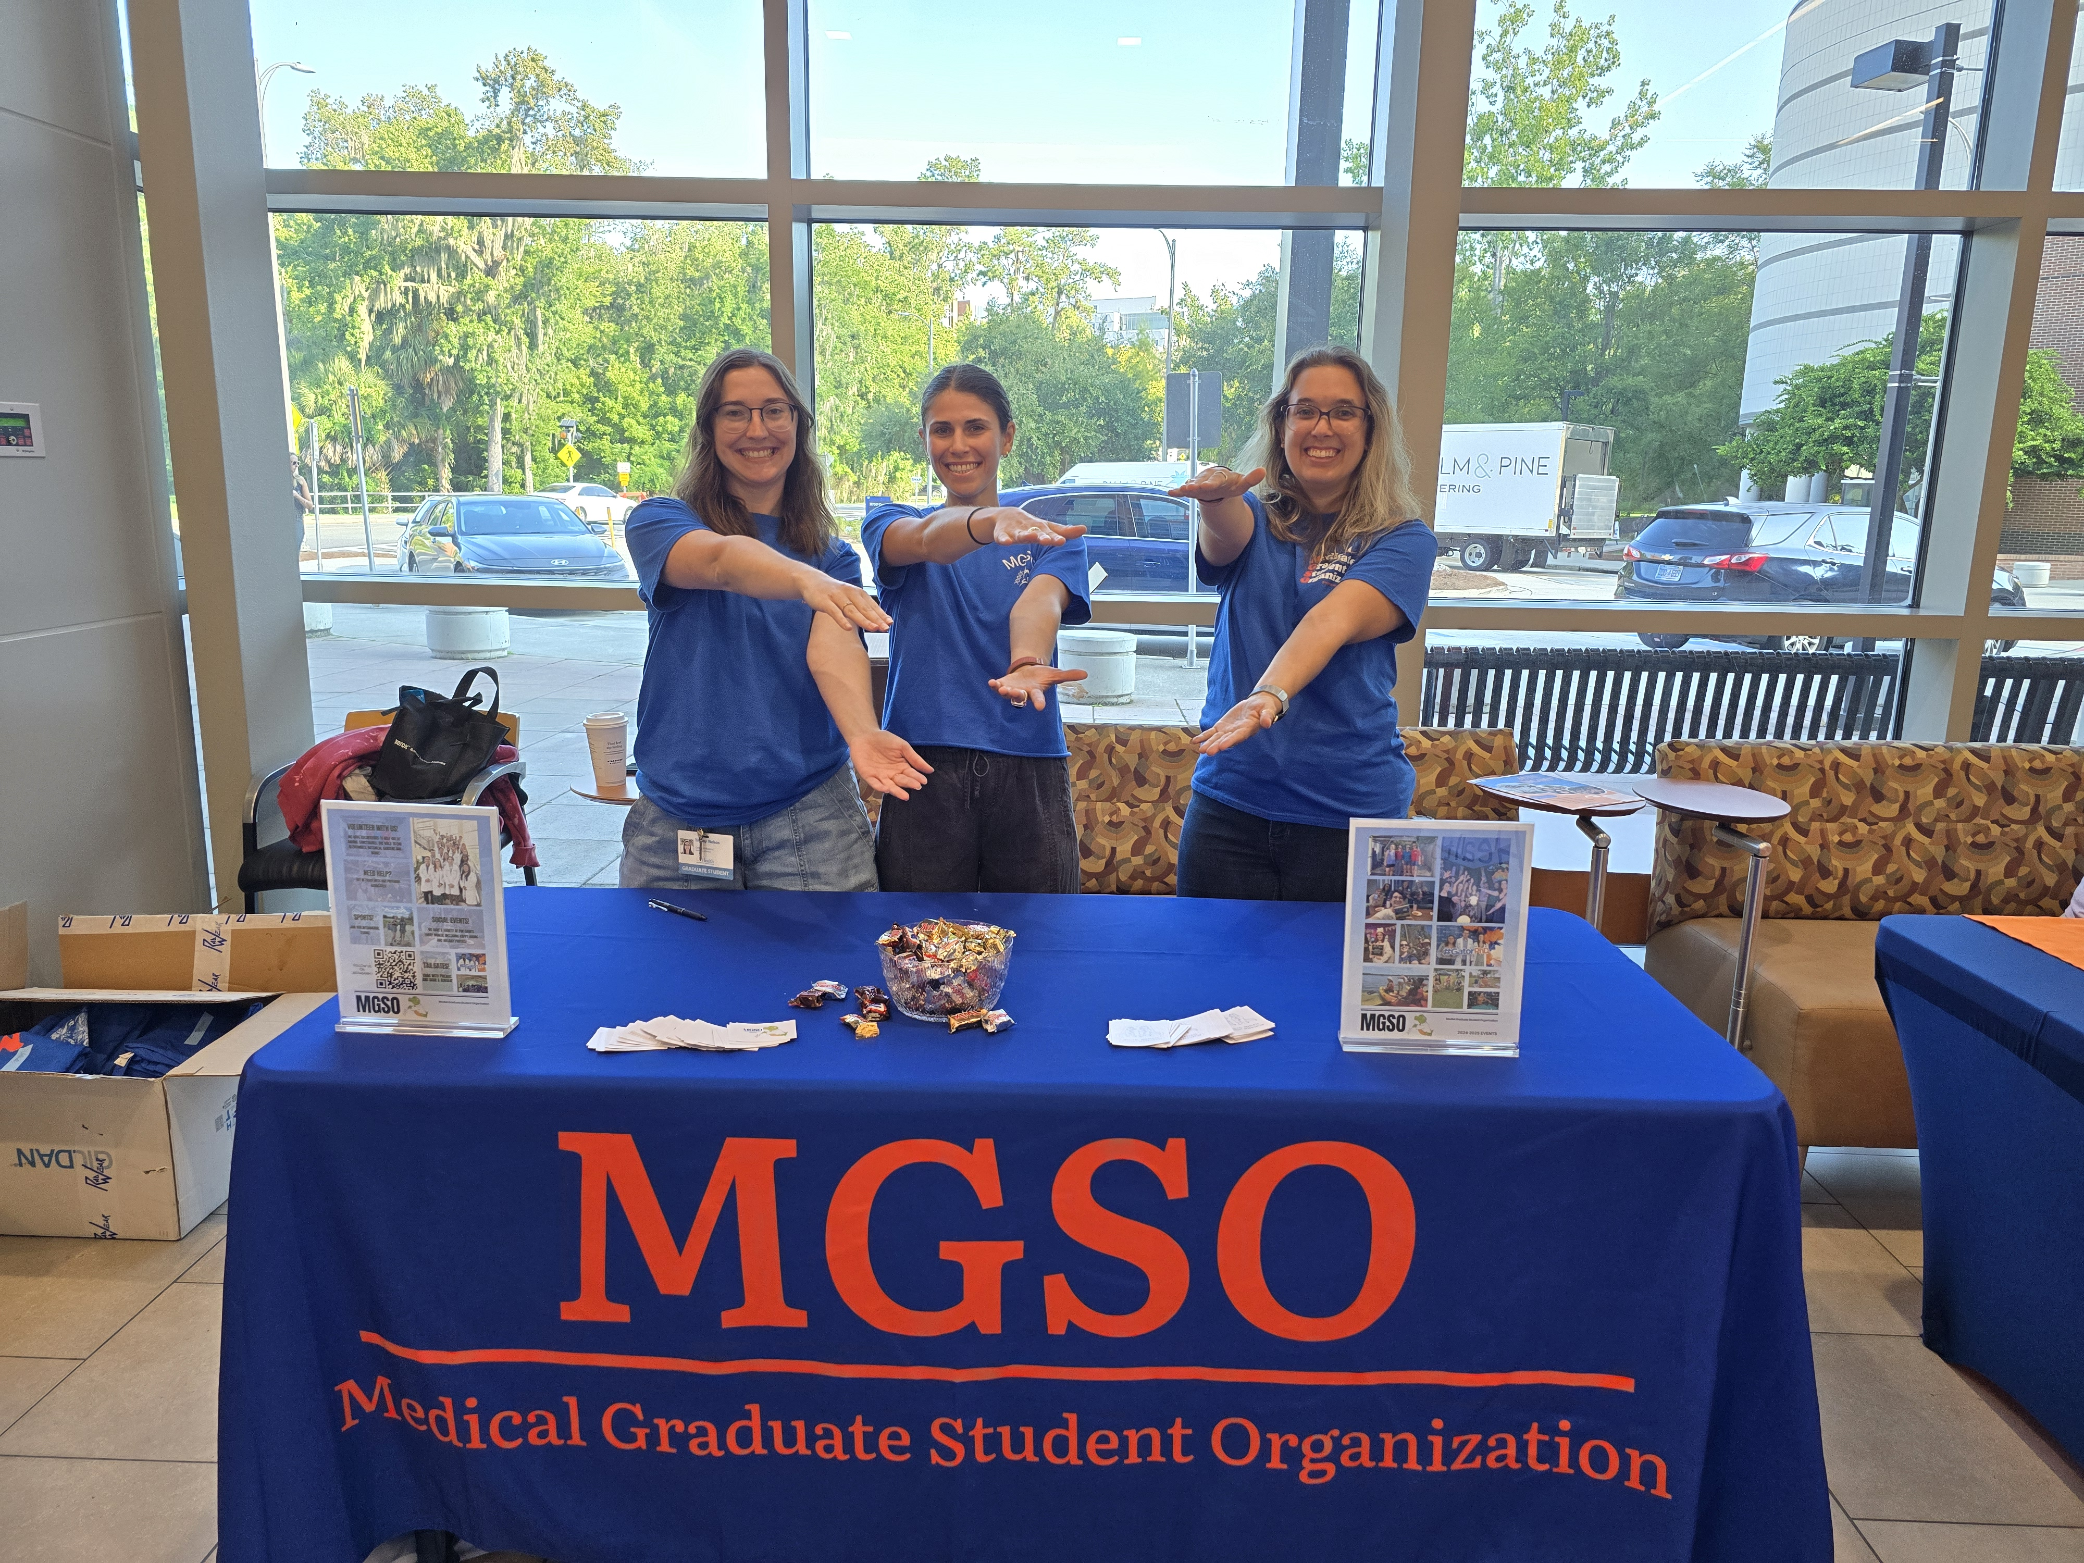
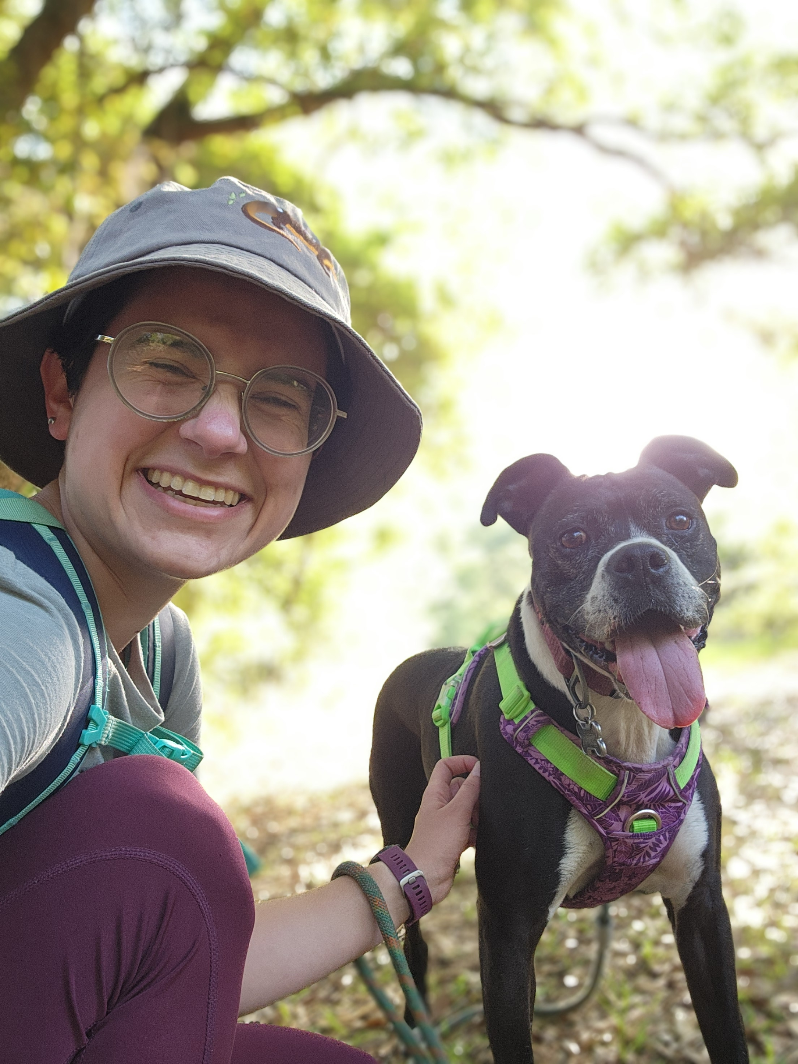
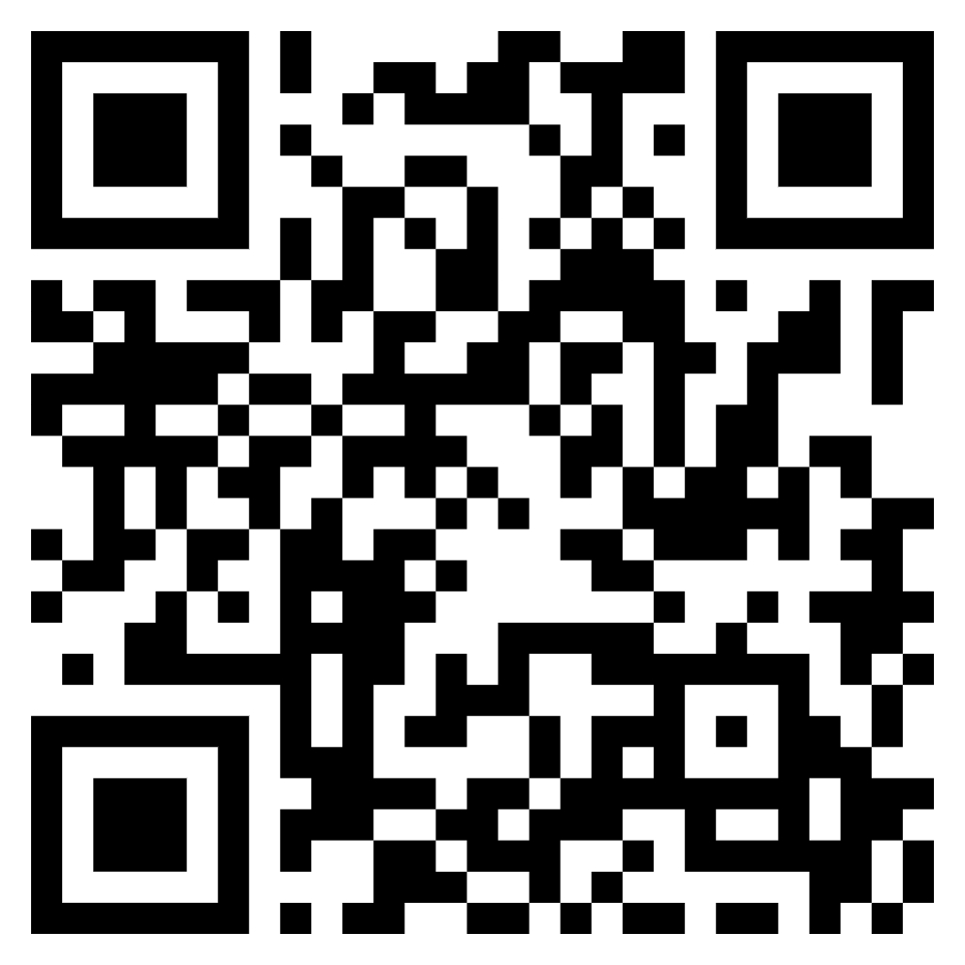
Secretary/Social Media Chair
Enter Photo Here
Enter Photo Here
Sydney Velasquez (She/Her)
3rd Year, BMS, Immuno/Micro
Announcements
Secretary: GBM reminders, Meeting minutes
Social Media: Updates and photos on Insta
Win an award?! Publish!? Receive a grant?! Let me know!
Officers! Send officer highlight info
Follow us! Send us photos!
Follow us on Insta!
Fun Fact!
Fall is migration season for many bird species! The Artic Tern travels one of the longest distances of any bird and are estimated to travel 1.5 million miles in its 30-year lifespan.

Slide 6
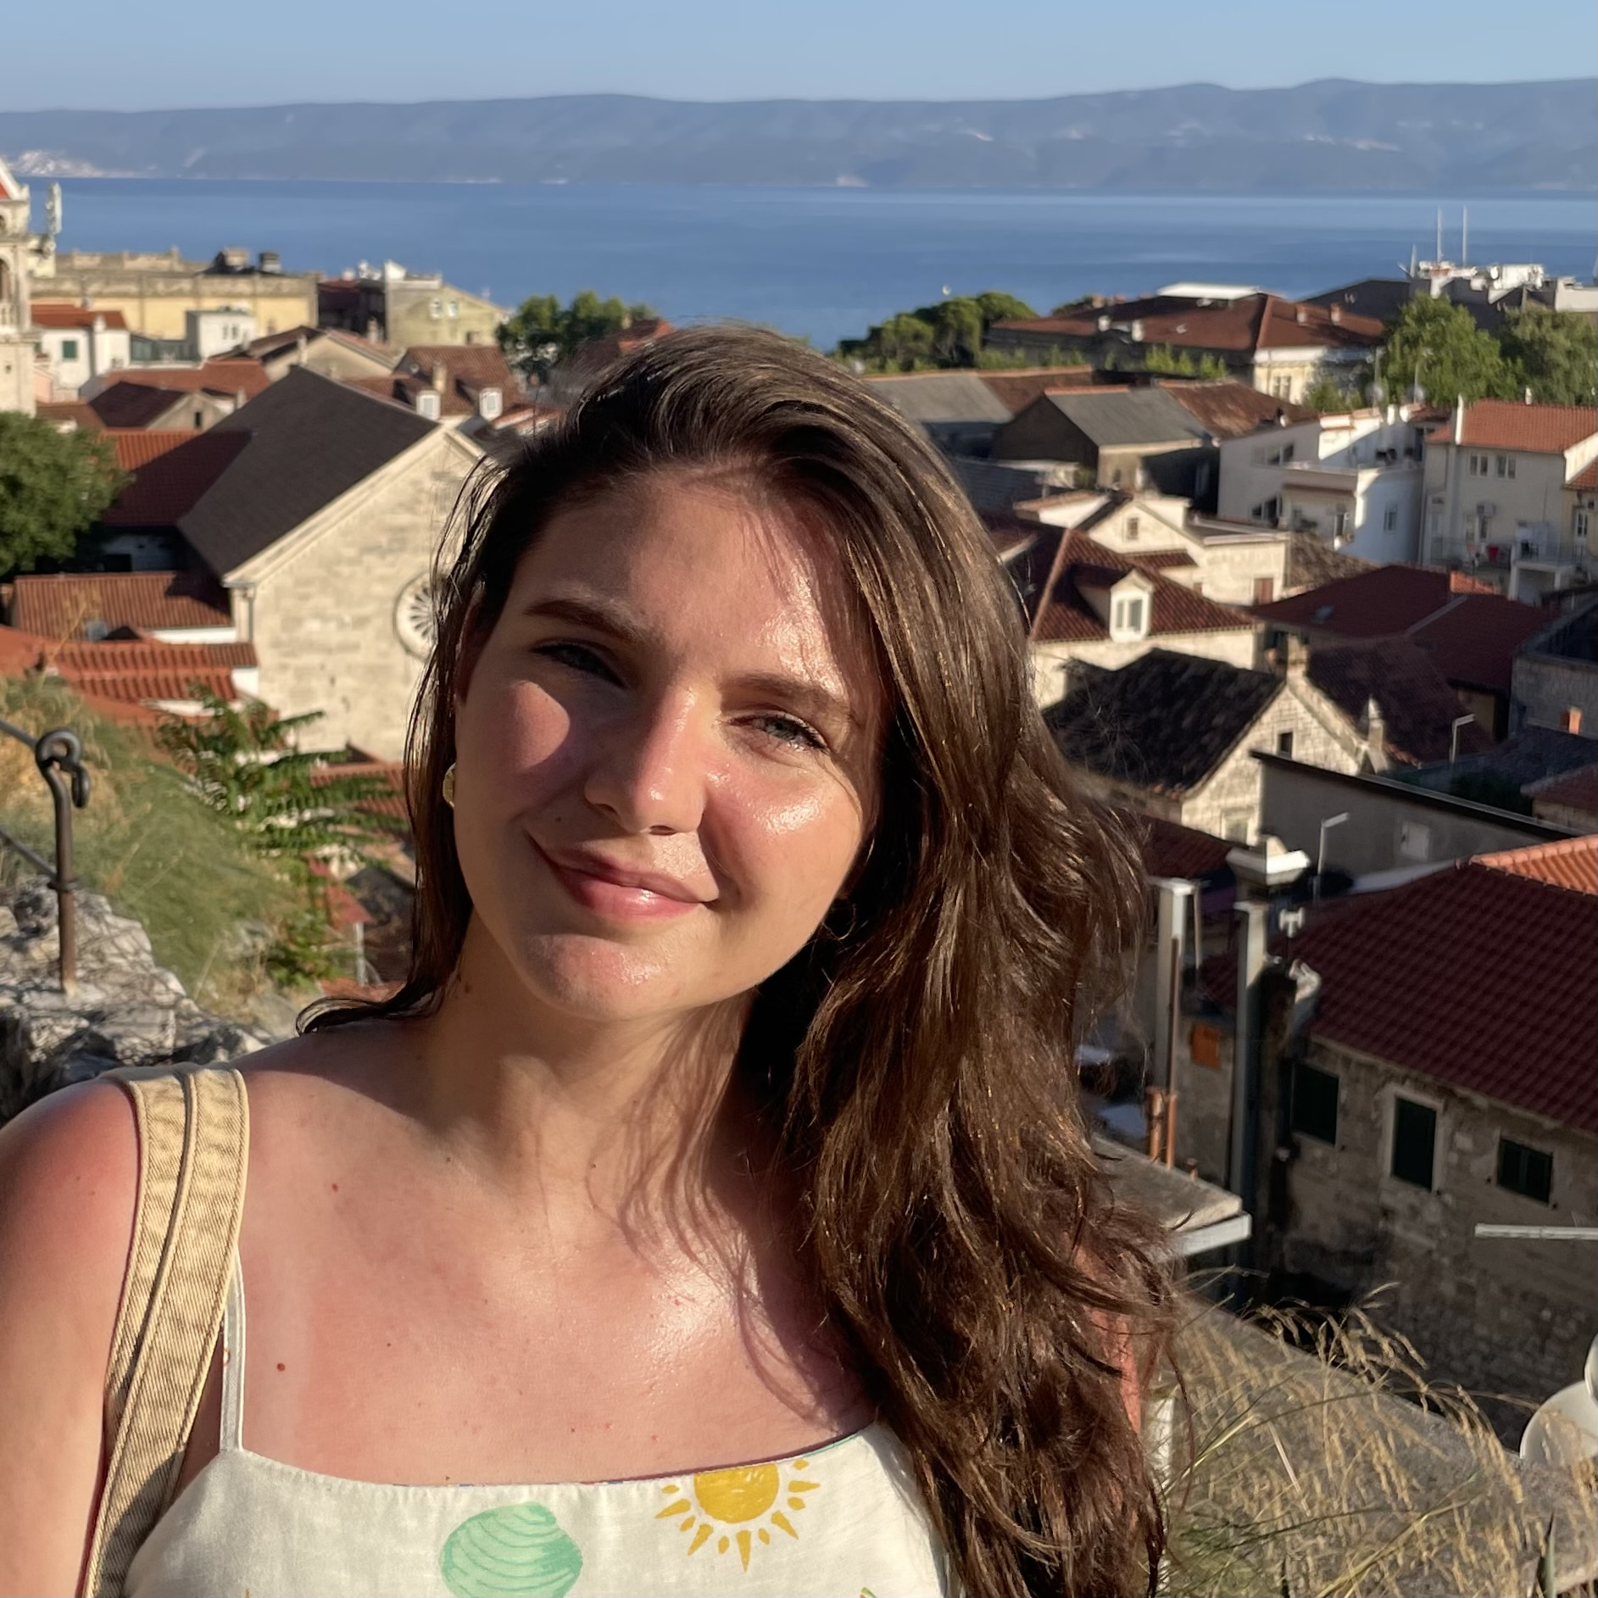
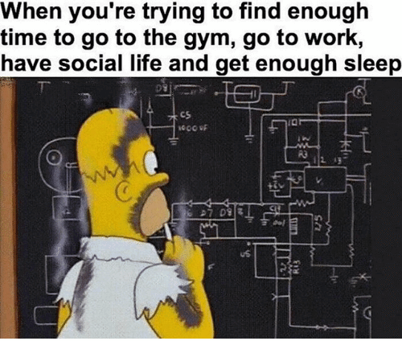
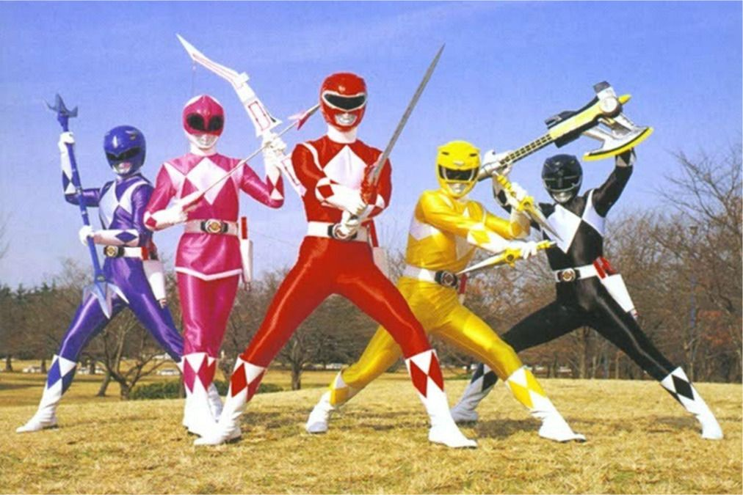
Social Chair
Maya Basic (She/Her)
2nd Year, BMS, Immuno/Micro
Announcements
Look out for future emails!!
Thursday Sept. 11th @ 6pm – Harn Museum After Dark: French Modern Exhibition (Monet, Matisse & more!)
Friday Sept. 19th @ 6pm – 1st happy hour! Google Poll will be sent out for location
Things going on in Gainesville:
Now thru Sept. 26th – Free Fridays Concert Series @ Bo Didley Plaza 7-9pm.
Saturday Sept. 13th
  Brazil Fest Gainesville 2025 @ Heartwood Soundstage 3-8pm
  Shrek movie night @ Bo Didley Plaza 8pm
Saturday mornings – Farmers markets (Alachua County, Haile Village, Waldo)
VisitGainesville.com has a great guide for all things happening in town!​
Reach out for any questions or comments! mbasic@ufl.edu
Fun Fact!
On this day in 1993, the first Power Rangers episode "The Day of the
Dumpster” debuted; in 2018 National Power Rangers Day was
formed and has since been celebrated every year on August 28th.

Slide 7
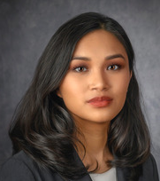
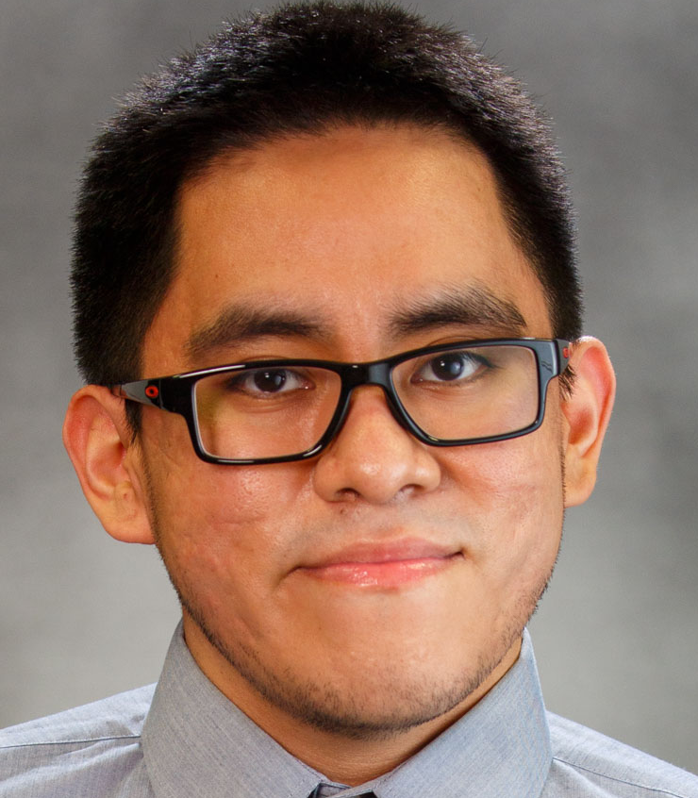
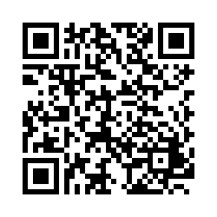
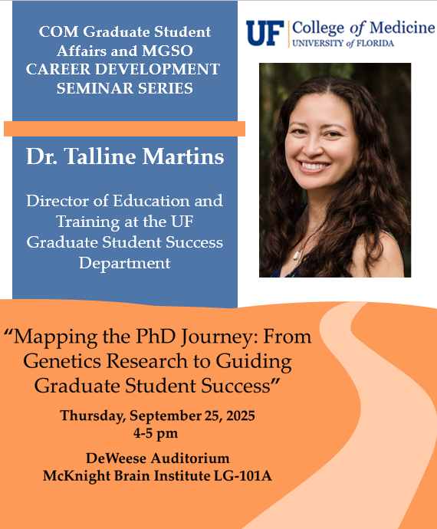
Career Development Chairs
October Bonus Event Interest Survey: Dr. Mark Fedele
Director of Medical Communications at Shionogi Inc.
Sydney Reed (she/her) 3rd Year, BMS PhD, Immuno/Micro
Rodrigo Tomas 6th Year, BMS PhD, Neuroscience
Announcements
Career Development Seminar Series: every 4th(ish) Thursday from 4-5 pm in the DeWeese Auditorium at the McKnight Brain Institute
  September 25: Kick off Career Development Seminar Series
    Dr. Talline Martins – UF Graduate School
  October 23
    Dr. Jeremy McIntyre – NIH
  November 20
    TBD
Workshops planned based on student survey conducted last semester: every 3rd(ish) Wednesday
  Workshops will approximately follow the theme of the Career Development seminar of the month – more details to come
Fill out the QR code interest form!
Fun Fact!
In 2014, August was the 55th most common name for newborn baby boys in Sweden, but only 22% were actually born in August.

Slide 8
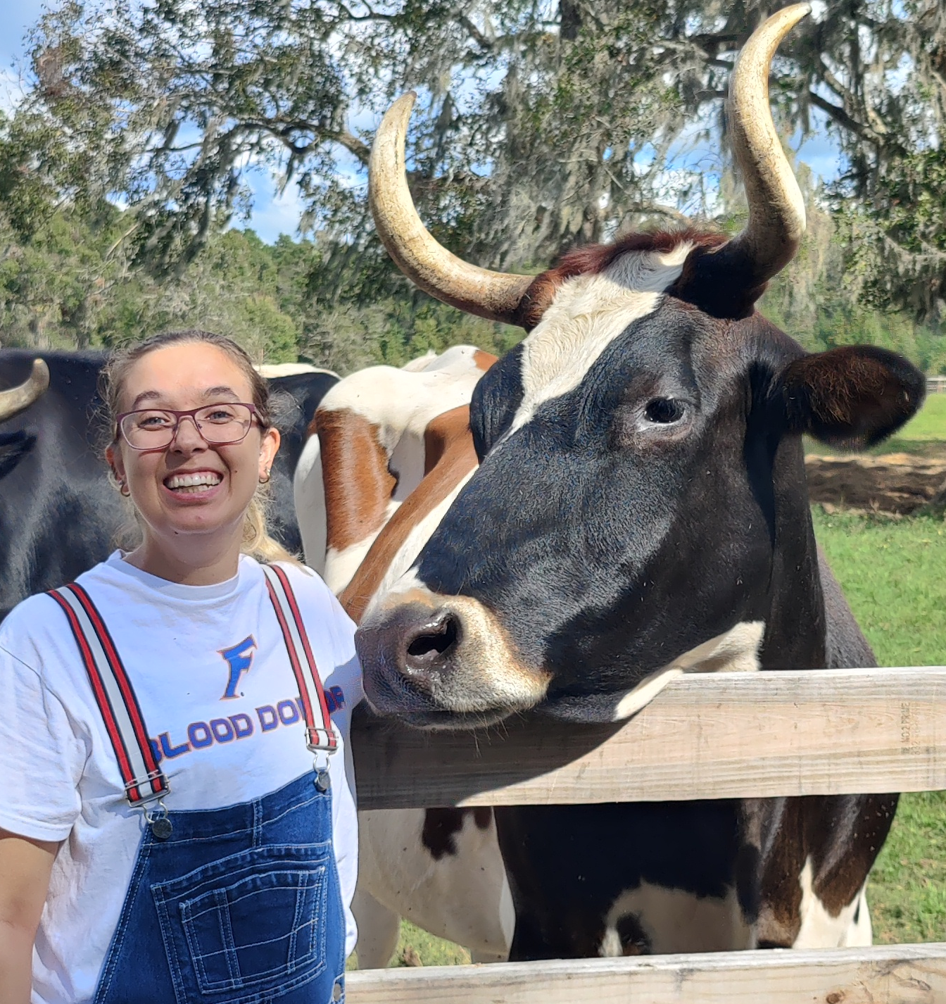

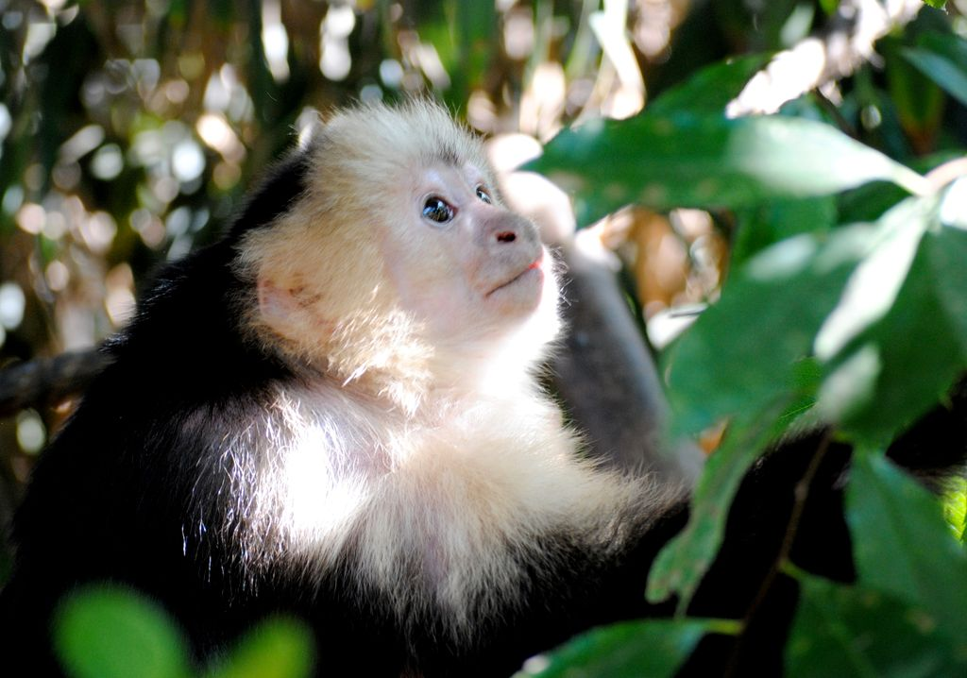
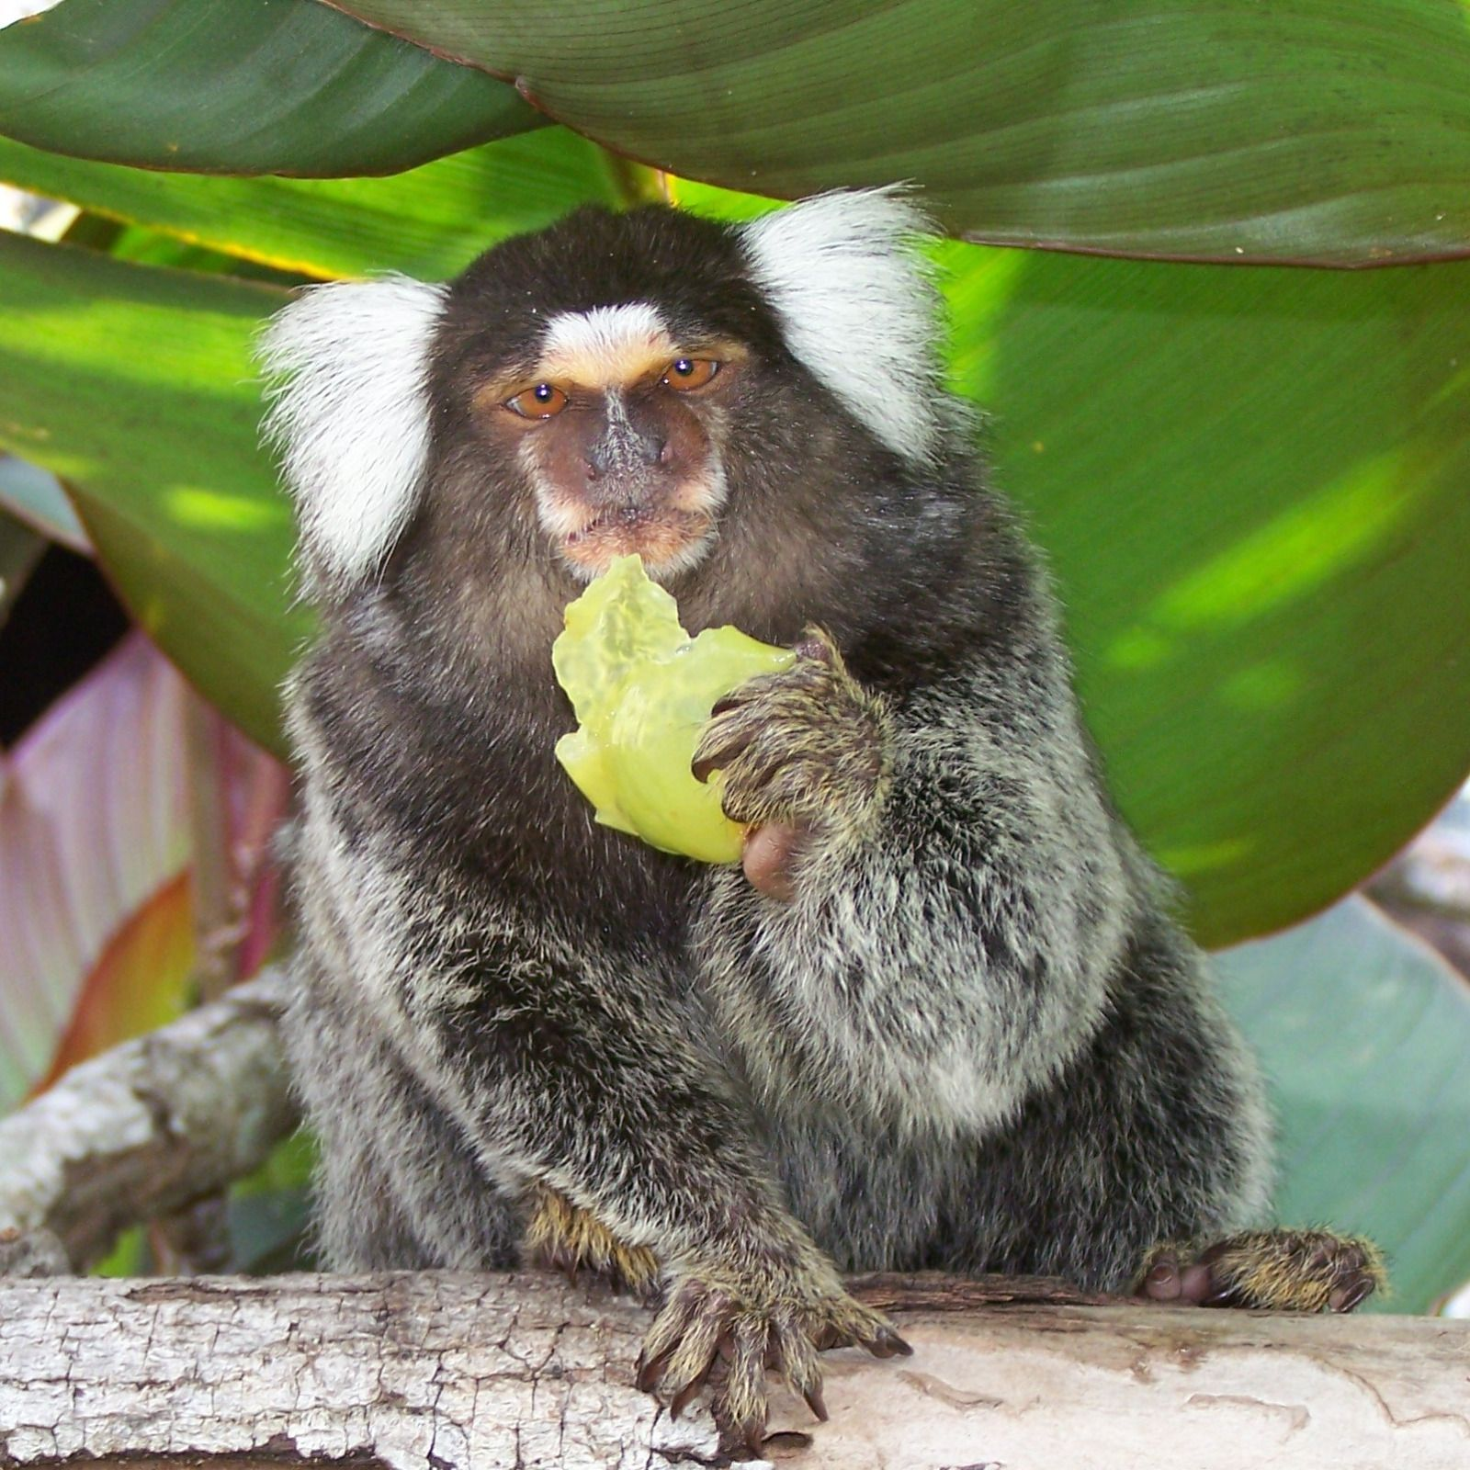
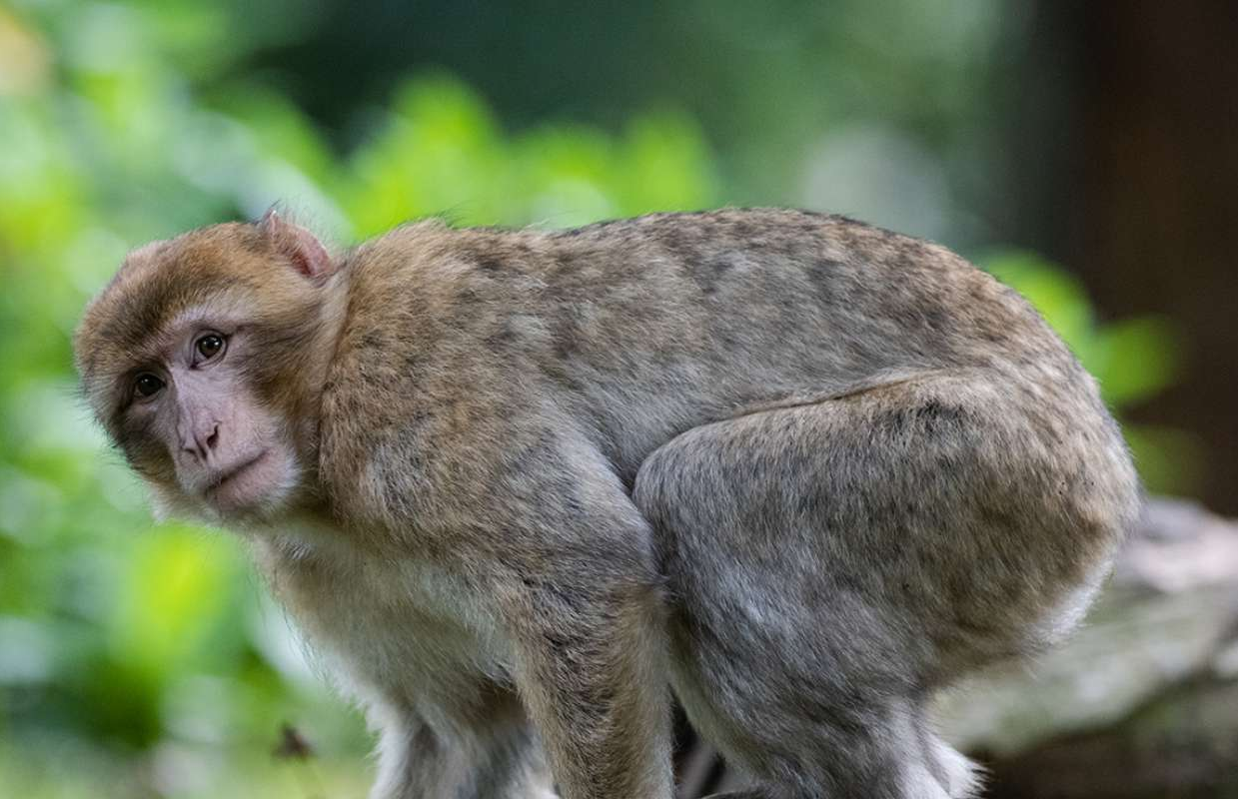
Community Service Chair
Valerie Hinsch (She/Her)
3rd Year, BMS, Genetics
Announcements
Reminder – officers need to attend 1 service opportunity academic year
Fall Service Opportunities are BOOKED!
  Jungle Friends Primate Sanctuary - Sept. 20th 9AM-1PM
    9 available slots – registration will close Sept 17th
    Signups go out Monday, Sept. 1st at 9AM
    Please only sign up if you are SURE you can go
    Willing to arrange transportation as needed
  Walk to End Alzheimer's – Oct 11th 8AM-12PMish
    Signup here: https://act.alz.org/site/TR?sid=23941&type=fr_informational&pg=informational&fr_id=18498
    Fill out section for "Day of Walk"
    Easy way for officers to get their 1 required service event!
  Habitat for Humanity – Nov 15th 8:30AM-2:30PM
    More info to come
Keep an eye out for emails
Feel free to email me (vhinsch@ufl.edu) service opportunities/ideas!
Fun Fact!
A general rule of thumb in primate identification is that monkeys have tails, while apes do not. However, Barbary Macaques are the exception to this rule, as they are monkeys without tails.

Slide 9
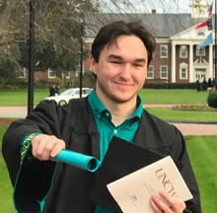
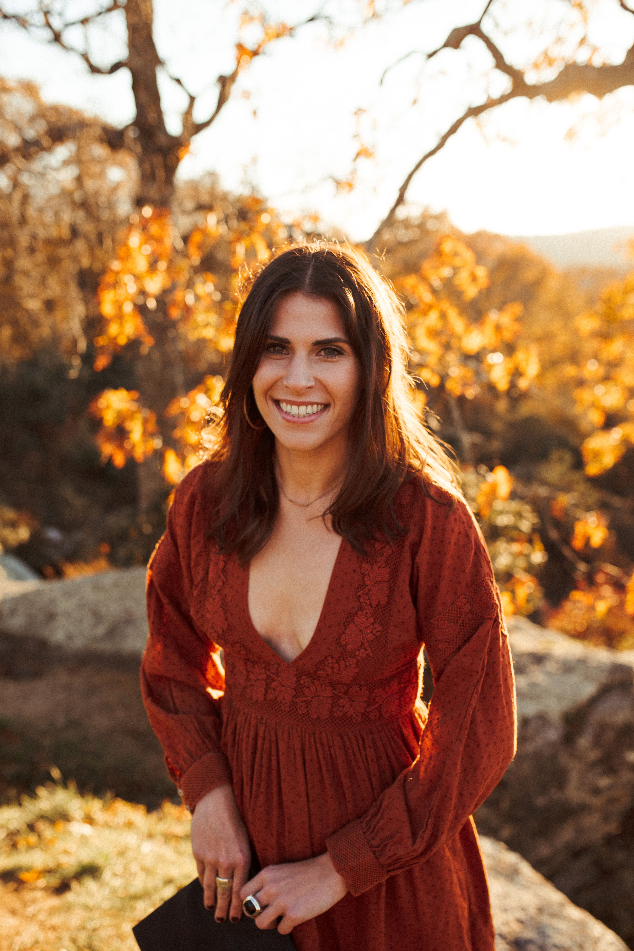
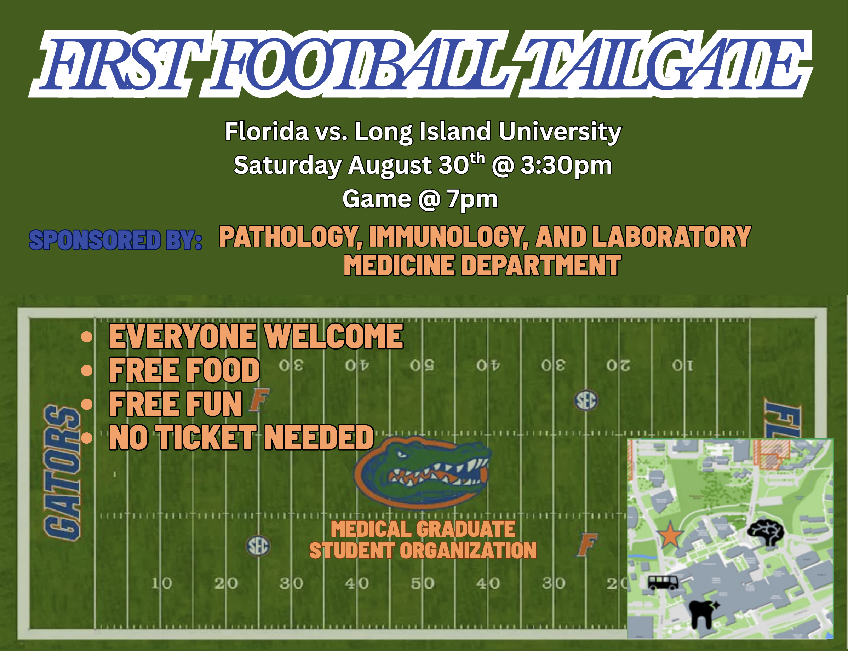
Athletic Chairs
Enter Photo Here
Emma Metcalf (she/her) & Jacob Davis (he/his)
2nd year, BMS PhD, Immuno/Micro
Announcements
Intramural Teams
  Sep 2nd is next round of registration- Flag Football
  Make sure to join WhatsApp gc's & click links to join teams
  If anyone is having trouble signing up please email me (emmametcalf@ufl.edu)
Tailgates
  1st Tailgate - August 30th @ 3:30pm!!!!! Be there or be square!!
  2nd Tailgate – September 6th @ Noon
  Other tailgates TBD until game times announced
Any relevant images or screenshots can go here
Fall Fun Fact!
Bobbing for apples was a U.K. dating technique from 14th century to 1800s

Slide 10
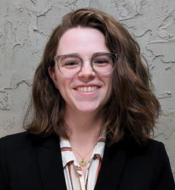
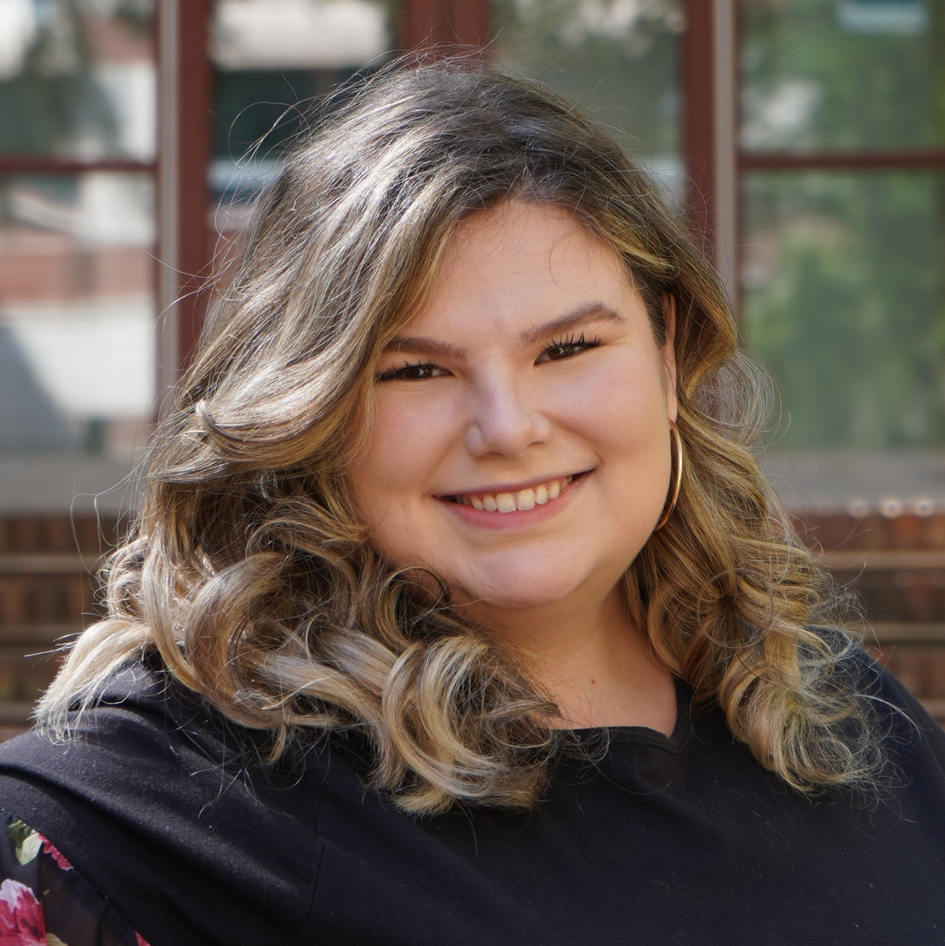


BMS Recruitment Chairs
Miranda Carter (She/Her)
4th Year, BMS, Immuno/Micro
Bianca Bean(She/Her)
4th Year, BMS, Physio & Cell Biology
Announcements
Orientation went well and the new class is settling in
  Thank you to everyone who volunteered to help out!
We will be sending out info about the first year rep position during the first week of September
Fun Fact!
The nickname “The Swamp” was given to the Ben Hill Griffin Stadium by former UF Football coach Steve Spurrier who noted “only Gators get out alive”

Slide 11
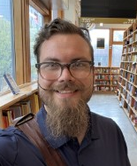
Ph.D. Advocate
Enter Photo Here
Dallas Galguera-Kelm (he/they)
2nd Year Ph.D. Student, Anatomical Sciences Education
Announcements
The anonymous reporting form is live. If you or anyone you know is having issues with their workplace, use the link below!
  https://forms.gle/p9PHTuN6xe7Qkbk58
Fun Fact!
Pumpkin spice's roots can be traced all the way back to the 19th century during the spice trade. It was first commercialized in 1933 as a ready-to-use spice mix and later was incorporated into limited-time-lattes by Starbucks in 2003 – the birth of the PSL.

Slide 12
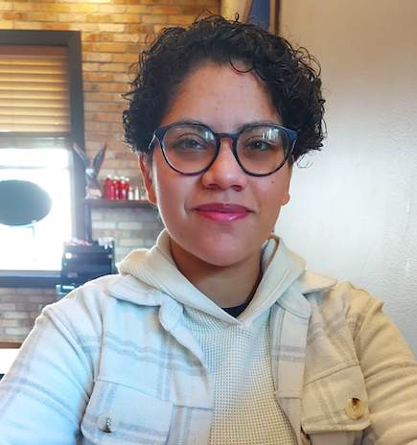
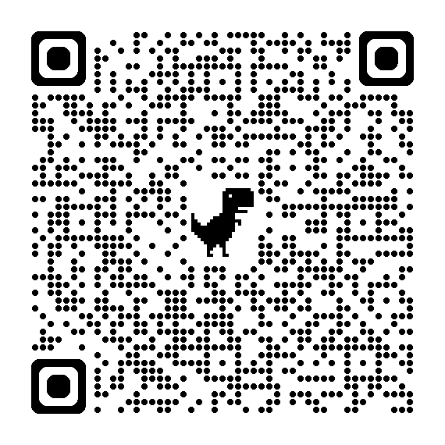
Master's Advocate
Enter Photo Here
Paola Parrales (she/her)
2nd year MS Student, Molecular Cell Biology
Announcements
Anonymous reporting form is live. Please share with COM graduate students!
  Access via QR code or MGSO website:
  https://gsovpres.wixsite.com/gsobms/anonymous-reporting
Anonymous reporting:
Fun Fact!
The full moon in the fall that occurs during the equinox is much brighter and rises much earlier than a typical full moon. The Harvest Moon was very helpful for farmers who used the moonlight to help harvest their crops. The 2025 Harvest Moon will occur on Monday, October 6!

Slide 13
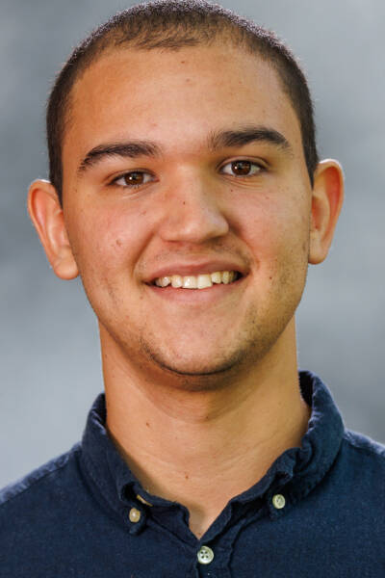
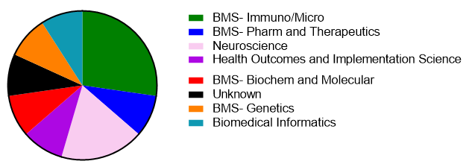
MD/PhD Advocate
Christopher (Chris) Mederos (he/him)
GS2, BMS, Micro/Immuno
Announcements
11 MD/PhD students have started in their graduate programs this semester
Anonymous reporting:
Fun Fact!
In September 1882, the unions of New York City decided to have a parade to celebrate their members being in unions, and to show support for all unions. At least 20,000 people were there, and the workers had to give up a day’s pay to attend.

Slide 14
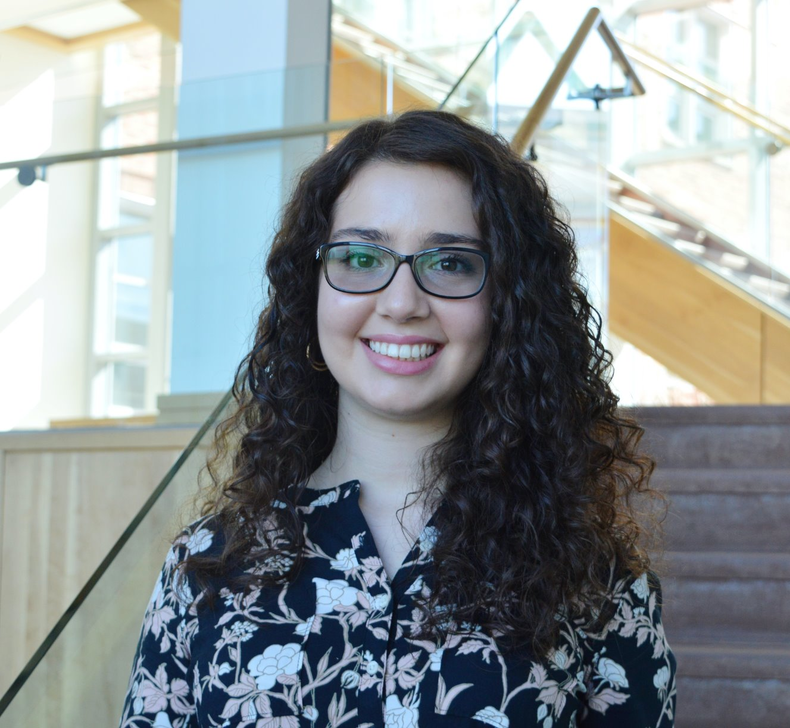

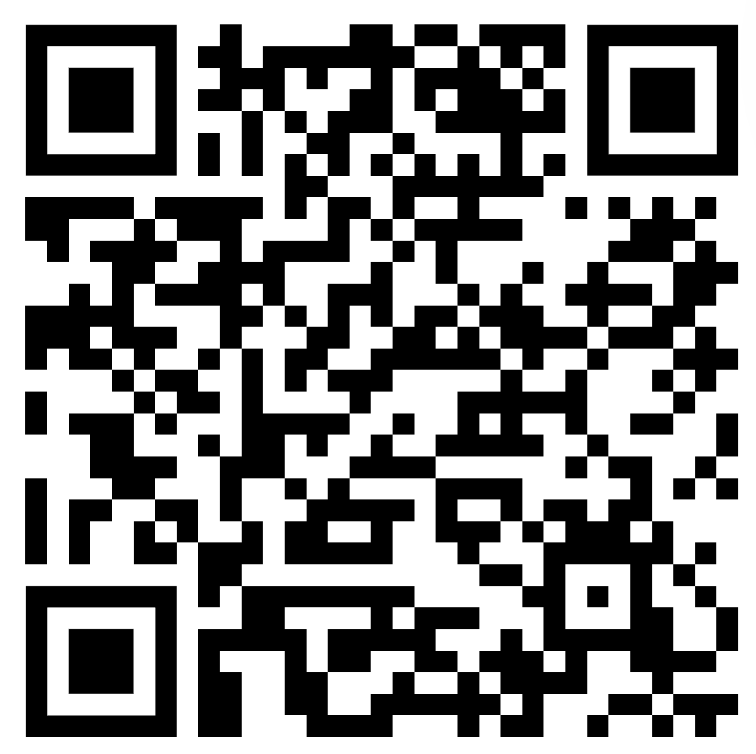
Graduate Student Council Rep
Amanda Pretory (she/her)
3rd year, BMS, Immuno / Micro
Full timeline:
Travel Grants
Upcoming cycle: 09/01 – 09/30
Domestic *conference* start date: 11/15 – 12/14
International *conference* start date: 12/01 – 01/31
Note: Eligibility used to be determined by travel start date. It is now determined by *conference* start date.
Grad Gator Greeting (Tomorrow!)
Resource fair: 11am-2pm
Grad Student Assembly: 2pm-5pm
Game night: 6pm-9pm
Fun Fact!
Sunflowers are hyperaccumulators with a preference for radioactive metals. They were used to help remove radioactive waste in the ground following the Chernobyl disaster

Slide 15
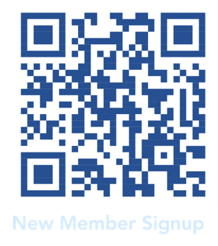
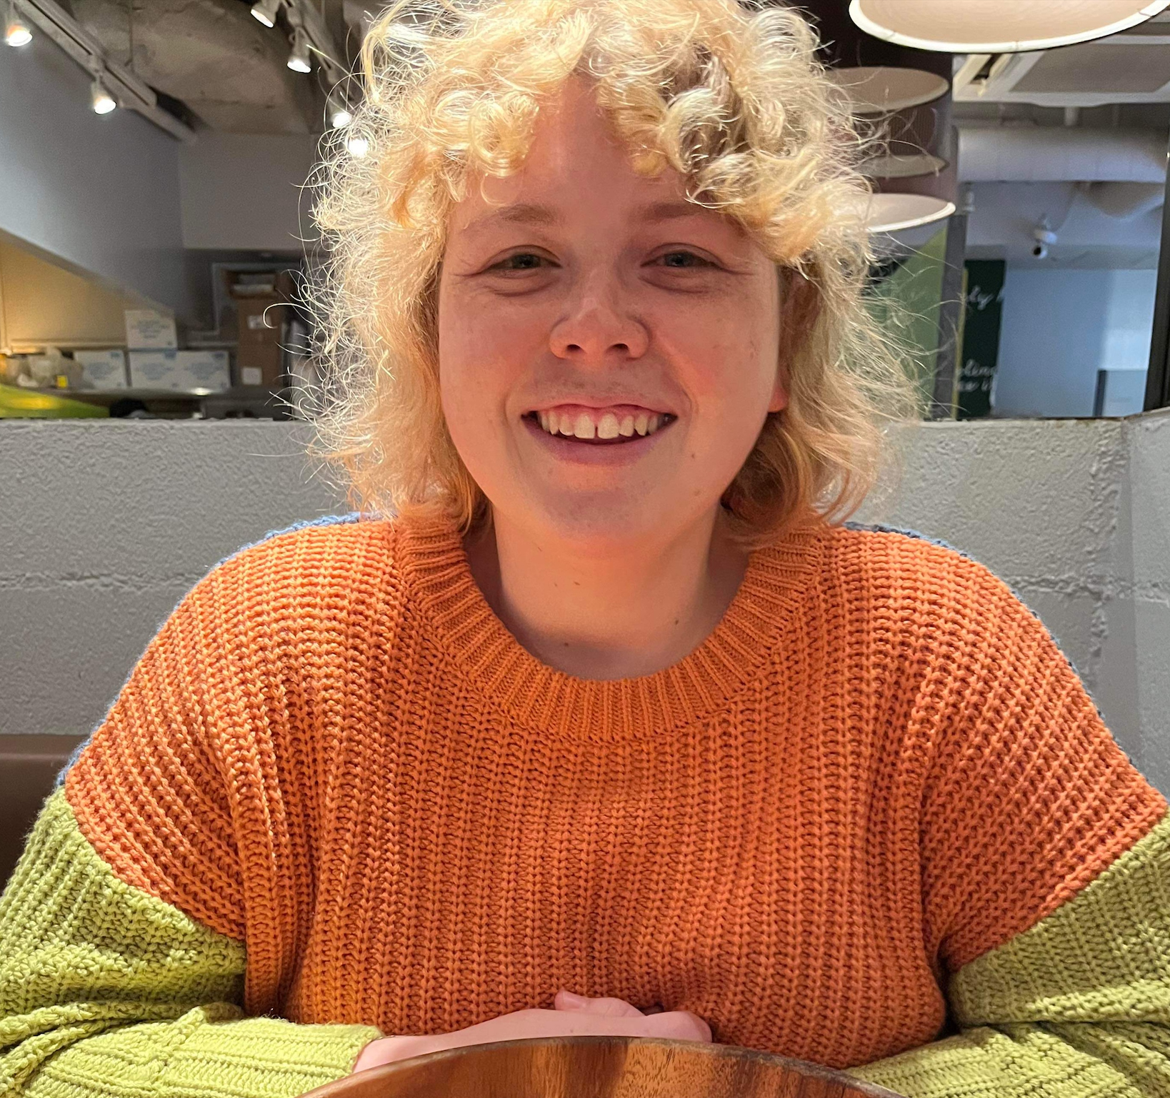
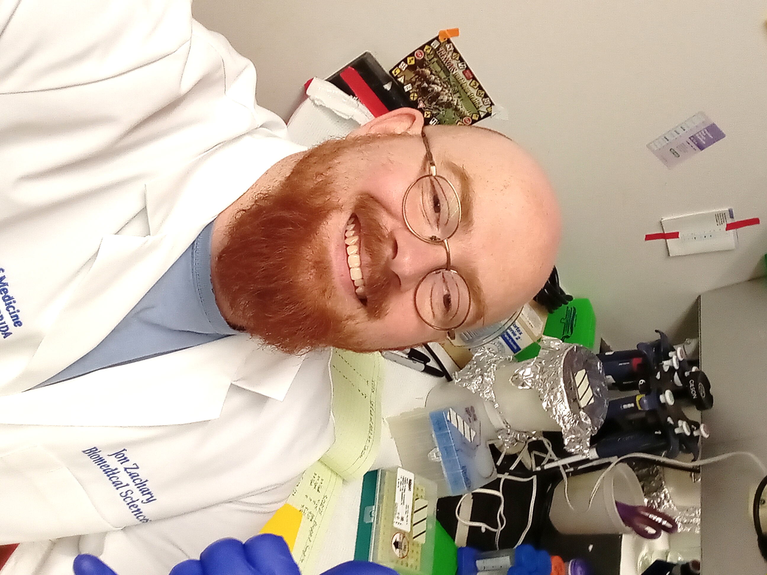
BMS External Board Reps
Enter Photo Here
Sorin Jacobs (she/her) and Jon Zachary (he/him)
5th Year BMS (Immuno / Micro) 4th Year BMS (Biochem)
Announcements
BMS coordinator meeting was rescheduled
GAU Updates
Due to UF's failure to discuss stipends and RT program we are at impasse
  Special magistrate hearing on Monday, November 17th – please attend to have GA voices heard!
GAU Welcome Back Social on Sunday, Sept 7th from 5-8 pm at First Magnitude Brewing
  Members receive 2 free drinks
  You can sign up there to become a dues paying member
GAU Sign Up!
Fun Fact: GRR Roller Derby Game on Saturday Aug 30th @ MLK Multipurpose Center 6pm. Come check it out!!
Notes:
increase in the minimum (the minimum yearly sum offered to GAs – old and new) for 9-month GAs from the current $17,000 to $19,200
increase in the minimum for 12-month GAs from the current $22,700 to $25,600. Both of these raises to the minimum will be applied to current and incoming GAs as long as the CBA is valid.
Merit-based raise: $533 for 12-month GAs, and $400 for 9-month GAs
Everyone who has NOT been formally reprimanded (i.e., written reprimand or suspended) over the last 1 year will receive this raise. If you have been reprimanded, and you win a grievance against that reprimand, you will be retroactively given the amount of the raise.
Merit raise will be a one-time, but permanent increase to whatever your base salary is. You will not automatically get another merit raise next year.
Maintenance of fee relief: we will continue to receive ~$200 in fee relief in Fall and Spring semesters (and the proportionate amount in Summer).
Overall, while GAU maintains that these sums are not close to a living wage in Gainesville, we think these are best concessions for now. In relative terms, this is the biggest increase in GA minimum stipends in the history of UF, more than twice of what we have ever gotten in a 1-year period. Moreover, financially hard-pressed people need the increase now. And increase to the minimum will affect roughly 1,000 people, which is ~25% of all GAs at UF. Thus, although we will continue to push for higher pay and better working conditions, we believe that this is a practically sound offer to agree with right now.
Therefore, we are bringing this tentative agreement for a vote to you! All of the >4,000 GAs at UF are eligible to vote on it with a secret ballot (provided at voting booth) to either approve or disapprove it. Voting booths will be be available at Reitz Union entrance facing the lawn on:
Wednesday, Sept 20th: 9:00 am to 12:00 pm (noon)
Thursday, Sept 21st: 9:00 to 11:00 am
Friday, Sept 22nd: 9:00 to 11:00 am

Slide 16
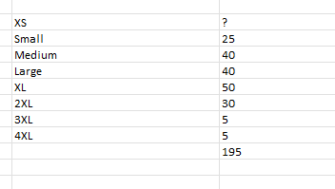
Crewneck Designs!!
Color: Gildan Heavy Blend™ Crewneck Sweatshirt | Product | SanMar
Design: (will put final design here after we look at Canva)
Needs to be one color on front

